Slide 1
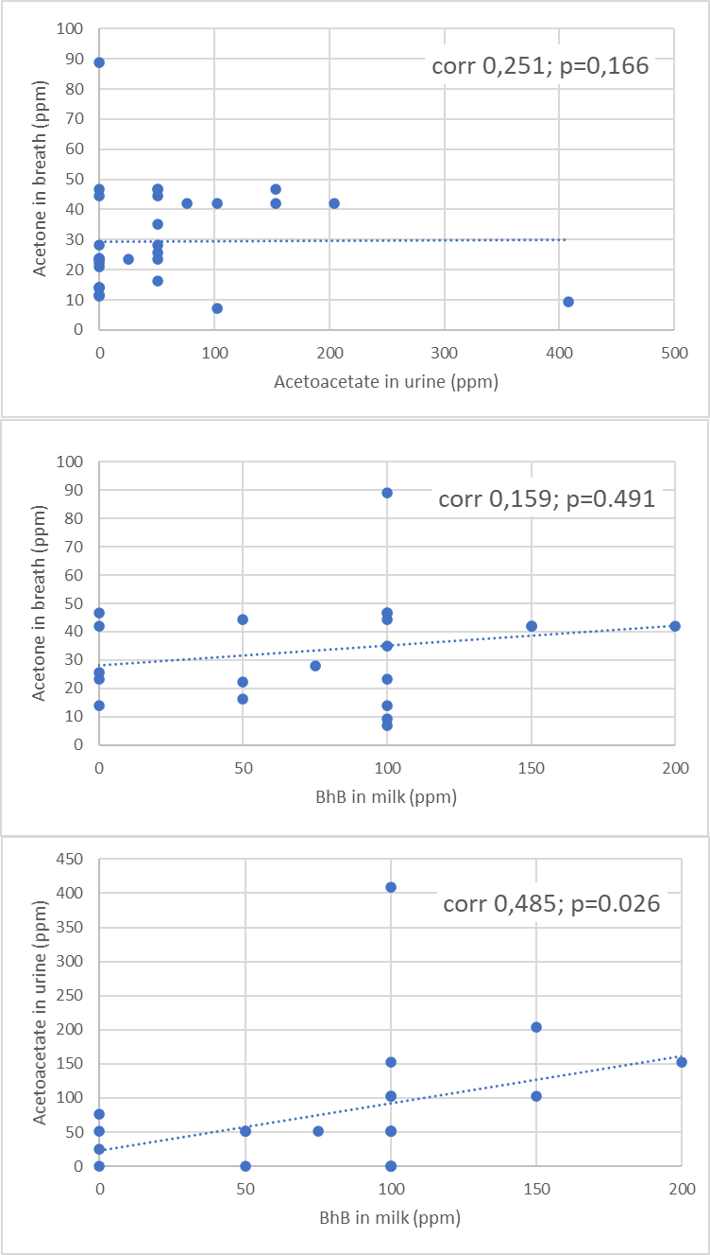
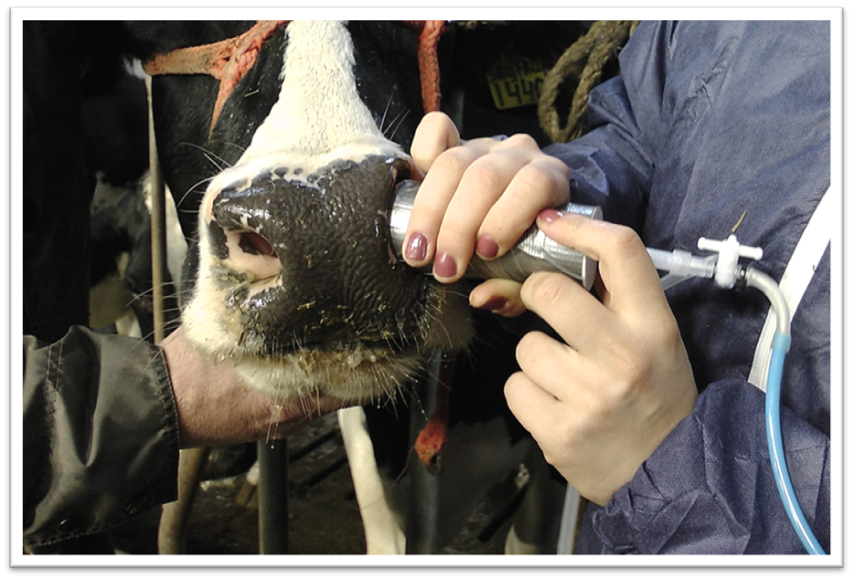
Ketosis in dairy cows and breath analysis
Validation of breath sampling method for its possible role in early warning for ketosis
Liesbeth G. Dingboom (PhD, DVM) and Lenny van Erp (PhD, Professor PLF)
HAS University of Applied Sciences, ‘s Hertogenbosch, the Netherlands
Results Concentration in ppm of acetone in breath related to acetoacetate in urine (upper graph) and β-Hydroxybutyrate in milk (middle graph); concentration in ppm of acetoacetate in urine related to β-Hydroxybutyrate (BHB) in milk is demonstrated in the lower graph. Correlation and p-values from Spearman correlation analysis.
Introduction
Traditionally, for diagnostic purposes of ketosis (due to a negative energy state), the occurrence of ketone bodies is measured in urine or milk with commercially available existing sticks. Breath analysis in dairy cows is relatively new and relevant for the development of automatic sensor systems for early warning. The purpose of this study is to validate the outcomes of breath analyses by comparing them with already accepted methods.
Conclusion
Outcomes from breath analysis as performed in this study appeared not to be comparable to outcomes of accepted ketone body measurement methods. However, breath analysis is promising for early warning because acetone occurred in breath while none was found (yet) in urine or milk.
Methods
-Six Holstein-Friesian cows were sampled max 6 times
-Breath for acetone using a nostril sampler and a Kitagawa® AP-20 pump (acetone detecting tube 102SD) with measuring range 20-5000 ppm per pump stroke of 100 ml
-Urine for acetoacetate using commercial Keto test strips with measuring range < 0.5 mmol -16 mmol per liter
-Milk for β-hydroxybutyrate (BHB) using a PortaBHB milk ketone test-strip with measuring four categories from 0-99 µmol up to 500+ µmol per liter
-All outcomes were converted to ppm
-Correlations were tested using Spearman correlation analysis

